Slide 1

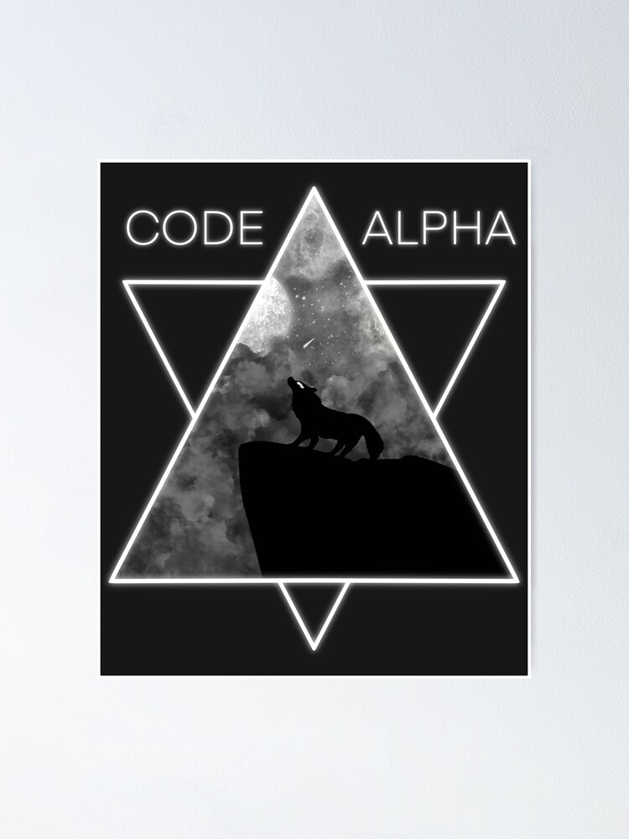

Python Devoloper In CodeAplha
Name : Valuvajjala Maheshwar rao (21CS002430)
Abstract/Intro/Motivation
Objectives
Results/Discussion
This project focused on modernizing the Apex command codebase by developing a new plugin framework using oclif. The goal was to enhance performance and user experience. Motivated by the need to improve tool efficiency, the project addressed existing issues, optimized command functionality, and demonstrated a commitment to advanced development practices.
The objectives of this project were to modernize the Apex command codebase by creating a new plugin framework with oclif. This involved enhancing command performance, resolving issues related to code coverage and output, improving user experience, and providing a more reliable and efficient toolset for developers.
The project effectively modernized the Apex command codebase, utilizing the oclif plugin framework to achieve substantial performance improvements and enhanced reliability. Key issues such as slow response times and incomplete output were resolved, leading to a more efficient and user-friendly experience. The successful implementation of these enhancements not only met but exceeded the project objectives, demonstrating significant advancements in tool functionality and providing tangible benefits for developers.
Background
Methods
Future Directions
The project was undertaken to address performance and reliability issues within the Apex command codebase. Existing tools faced challenges with slow response times and incomplete outputs, affecting developer efficiency. Utilizing oclif, the project aimed to modernize these tools, enhance functionality, and improve the overall user experience.
The project employed oclif to develop a new plugin framework for modernizing the Apex command codebase. Methods included designing the framework, optimizing command performance, integrating enhancements, and conducting rigorous testing. User feedback was incorporated to ensure improvements addressed issues effectively and enhanced overall tool functionality
Future work includes expanding the oclif plugin framework with additional features, improving documentation, and integrating continuous user feedback. Plans also involve ongoing performance monitoring, developing training programs, and exploring emerging technologies to keep tools updated and aligned with evolving developer needs and industry standards.
Notes:
feel free to change background colors & text boxes and use sections for difference purposes!

